Slide 1
Parent Group 2

Slide 2
Goal: Scripts and Strategies
Why: These are your basic tools for implementing Unstuck
Plan:
Review Flexibility and Time in Homework
Scripts briefly: What and Why
Strategies
  Accommodations
  Be a Good Coach
Do:
Check:

Slide 3
Review
Parents think of one time in the last hour they were flexible:
How could you narrate this to your child:
3. Look at “Time In” Plan and Check

Slide 4
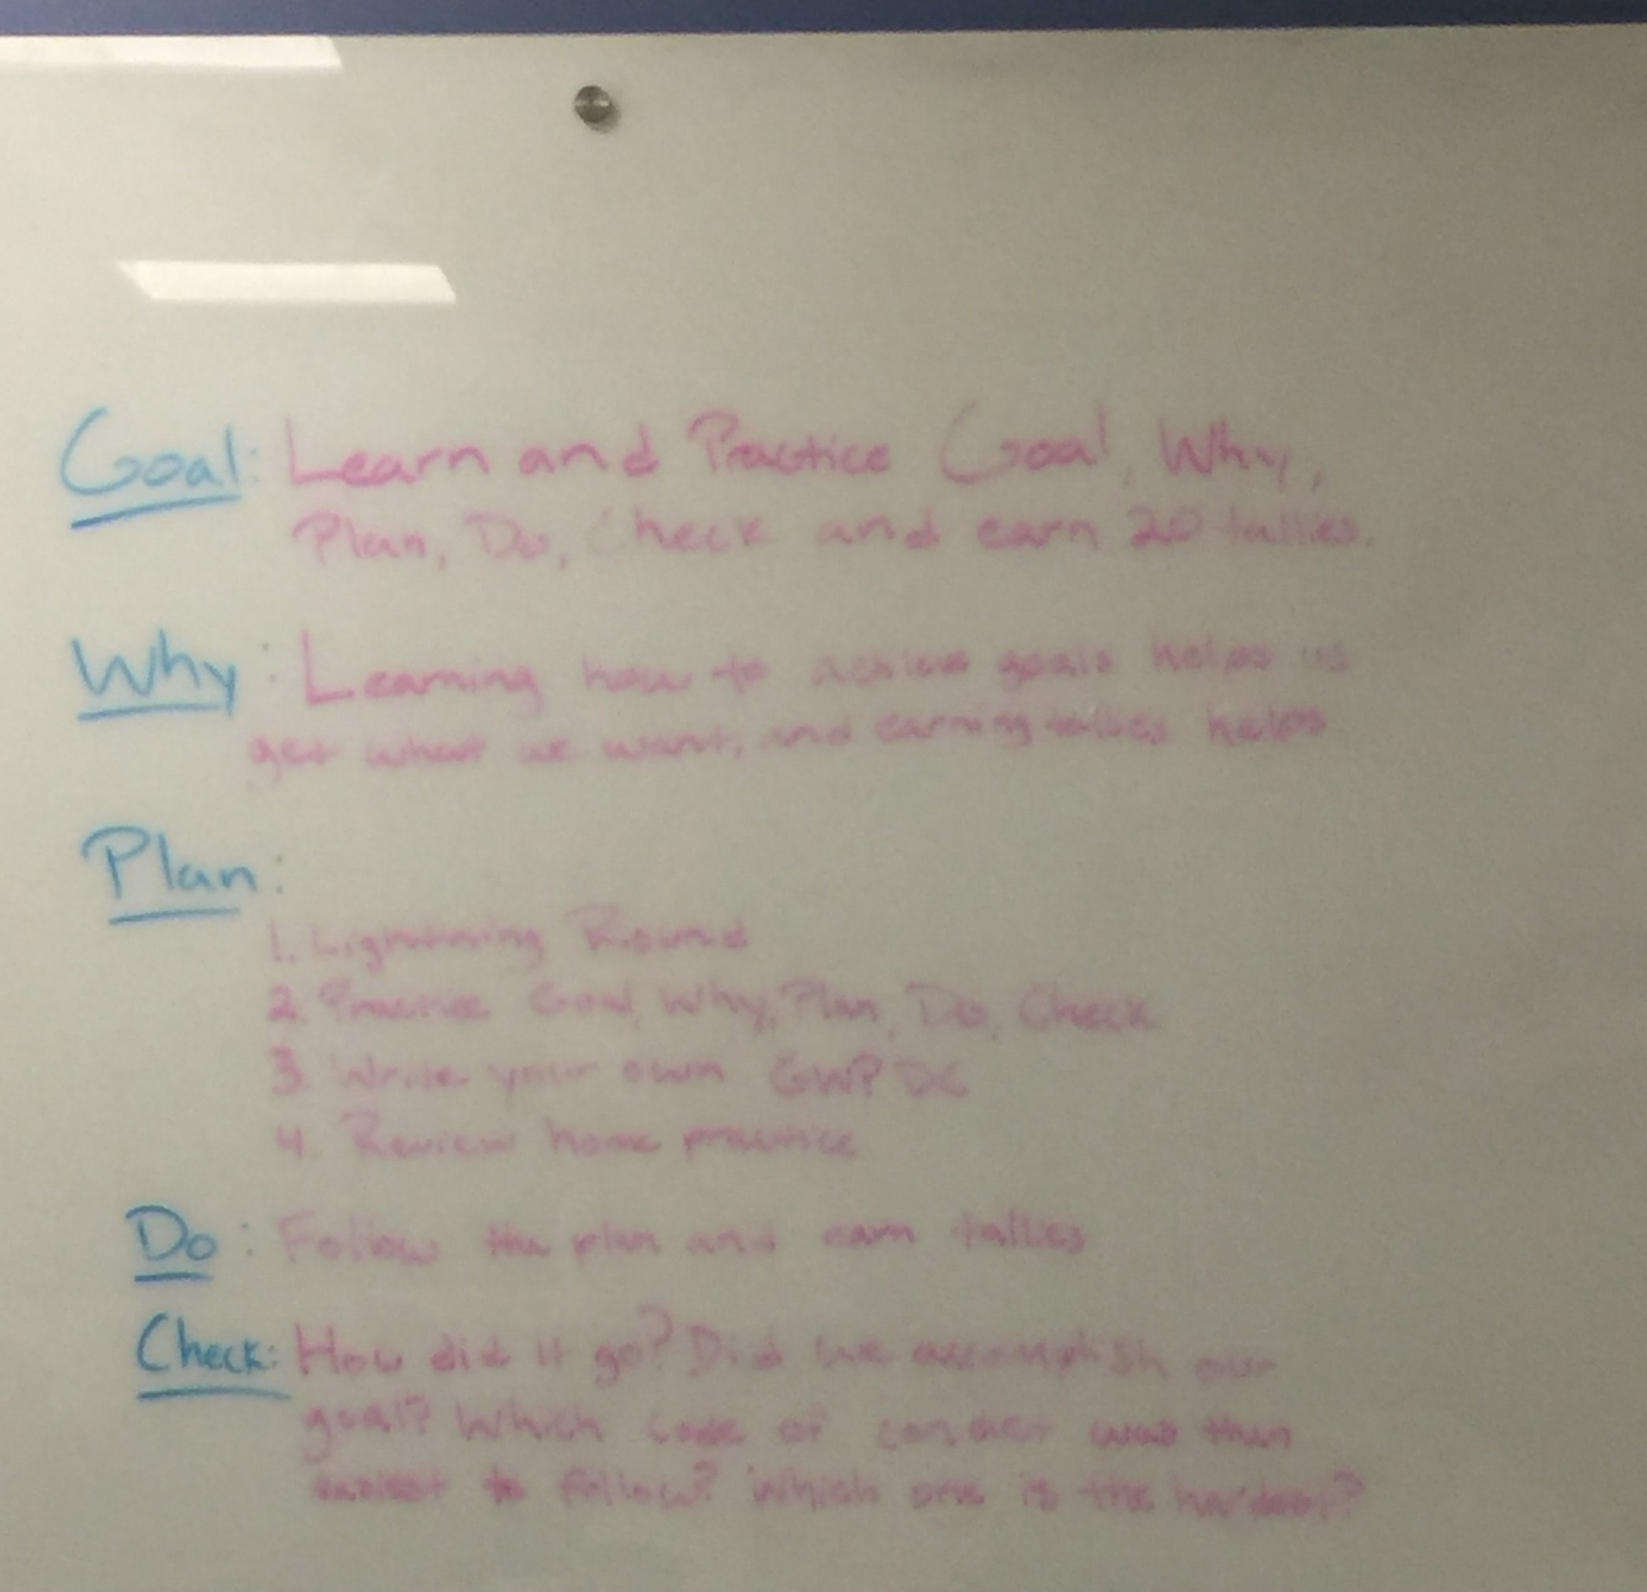

Slide 5
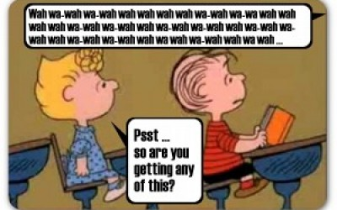
Teach Scripts
Scripts avoid too much talking
Scripts refer to a broader process
Scripts make an alliance—you’re helping
Scripts need to be practiced

Slide 6
Importance of Self-talk in EF
Social Context
Language
Self-directed speech
Self-regulation
Executive control
(Luria, 1961)
Notes:
6

Slide 7
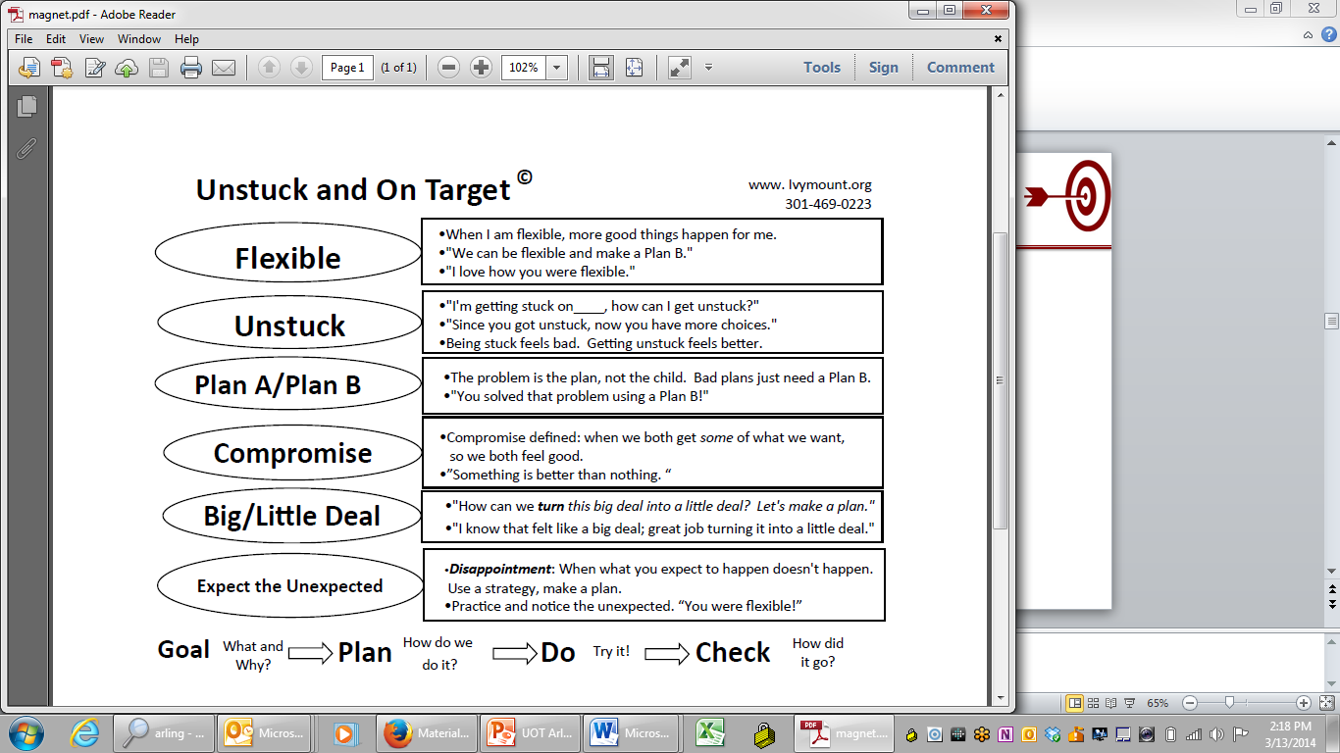

Slide 8
Narrate Your Life
Start by noticing flexibility
Narrate your own frustration and responses
Identify, neutrally, the situation.
  “I was so stuck today. It took me all morning to think of a plan b.”
  “You seem stuck. That’s ok, we’ll make a plan.”

Slide 9


Two ways to help
Accommodate
  Change the environment
  Change expectations
  Change the task
“An ounce of prevention is worth a pound of cure.”
Ben Franklin
Remediate
  Explain the rationale
  Introduce new concepts
  Teach new skills
  Teach a process
"Give a man a fish, feed him for a day. Teach a man to fish, feed him for a lifetime.”
Lao Tzu

Slide 10

Without Accommodation

Slide 11
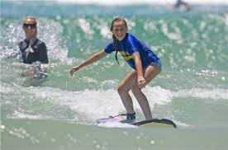
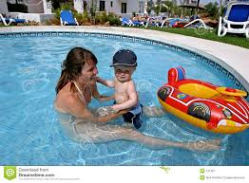

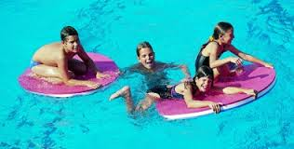
Target Goal: Learn to Surf
Plan:
SubGOAL:
SubGOAL: Enjoy the water (What’s the accommodation?)
SubGOAL:
SubGOAL: Learn swimming strokes

Slide 12
Task Modifications (to Accommodate)
  Reduced demands
  Break things down into small “chunks”
  Change order of demands
  Change visual presentation of work
  Provide choices
  If something doesn’t make sense to you it won’t to others
Notes:
12

Slide 13
Be a Good Coach!
Teach by doing—Active Coaching
Use visual supports
Keep it positive
Stay calm
Break it down—avoid overload
Teach Coping Strategies
Make sure you have motivation
Make it fun

Slide 14
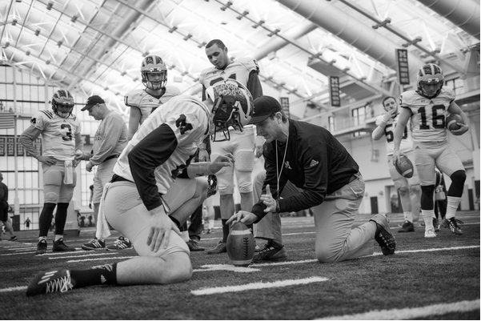
1. Active Coaching
Scaffold
Fade
Generalize

Slide 15


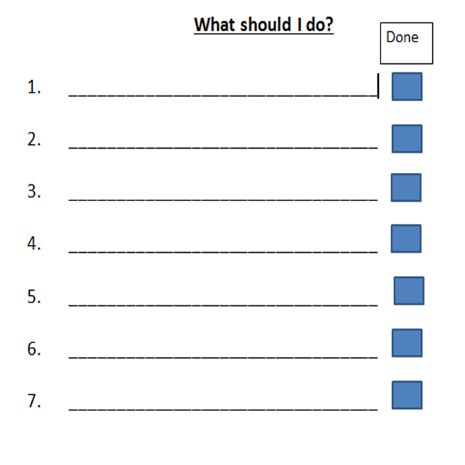
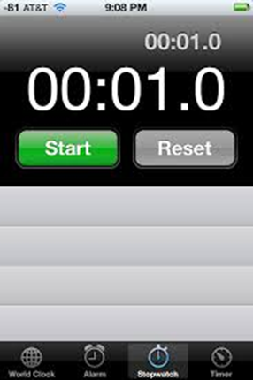

2. Don’t Just Talk—WRITE IT DOWN!

Slide 16
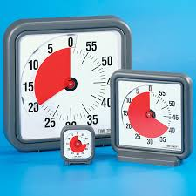
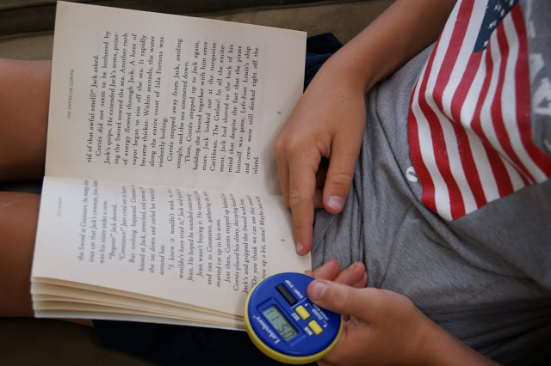


Iphone
Vis Timer

Slide 17
3. Keep it Positive
1
4
Praise
Praise
Praise
Praise
Correction or command
to

Slide 18
How to Praise
Must be for something that is hard
Must be specific
Must be true
You get more of what you attend to.
Use praise to reinforce VALUES:
  Hard work
  Persistence
  resilience

Slide 19
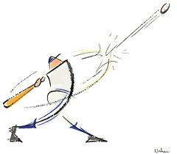
Learning by Reinforcing Incremental Progress
  Break down the task
  Figure out the “hot spots”
  More reinforcement for more appropriate, challenging behaviors along a continuum
  Less reinforcement for less “close” behaviors
Homeruns get more cheers than a base hit—but a base hit is good too!

Slide 20
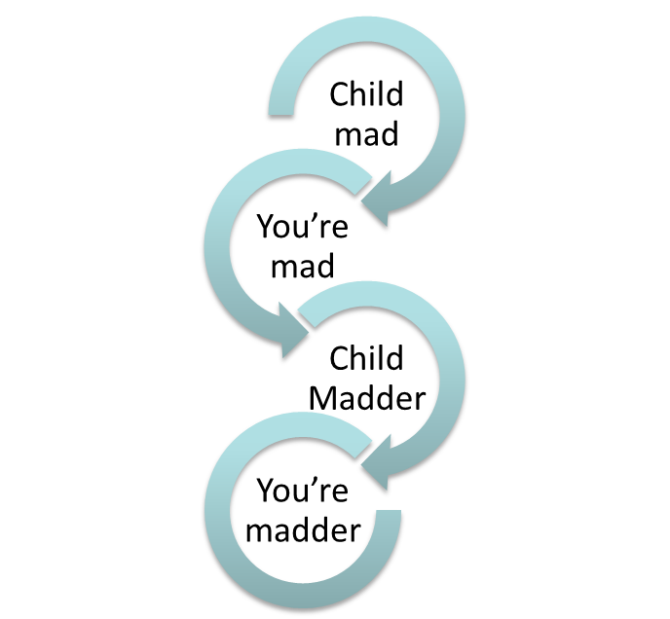
4. Stay Calm (or Pretend to)

Slide 21
Homework
1. Narrate YOUR life out loud
2. Incorporate an Unstuck script into something EXTERNAL too you child: TV, story, movie
3. Catch your child being flexible

Slide 22
Goal: Scripts and Strategies
Why: These are your basic tools for implementing Unstuck
Plan:
Review Flexibility and Time in Homework
Scripts briefly: What and Why
Strategies
  Accommodations
  Be a Good Coach
Do:
Check:

Slide 23
Homework
Review the Child extension
Narrate your life!
  Plan:
Think about for next group: How does thinking of yourself as a coach change your parenting?

