Slide 1
Parent Group: 1
Monica Adler Werner
mwerner@CAATonline.com
© Unstuck Authors

Slide 2
Goal: Get Organized and Oriented
Why? Because we all feel better when we know the plan!
Plan:
Prize certificates
Introduction to Unstuck
EF Scales
Do:
Check:
© Unstuck Authors

Slide 3
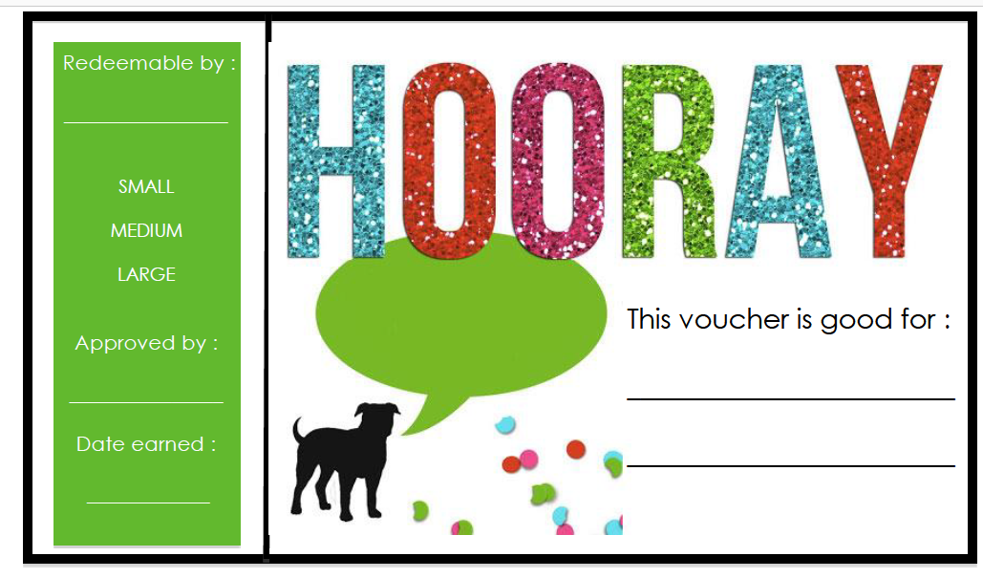
© Unstuck Authors

Slide 4
Motivation and Prizes
The work children are doing here is HARD
Why use external motivators?
Most important criteria for prizes:
  Something you WILL follow through with (and your children tell us!)
What are good certificate prizes:
  Small: earns in one group
  Medium: earns in 2-3 of groups
  Large: earns in 4-5 groups
© Unstuck Authors

Slide 5
What is Unstuck?
Parent Training
Community Training
Child Groups
Increased flexibility, goal setting and planning skills

Slide 6

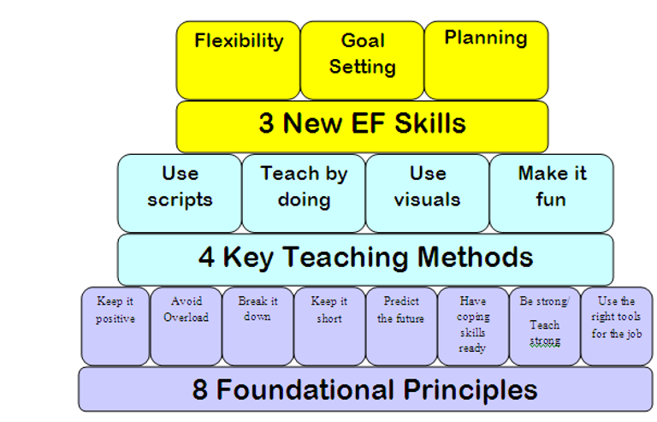

Slide 7
Unstuck Philosophical Underpinnings
Think Can’t not Won’t
Accommodate to Remediate
Collaborate (and you can still be authoritative)
Teach, Reteach, Reward
What you reinforce you get more of or what you pay attention to you get more of

Slide 8
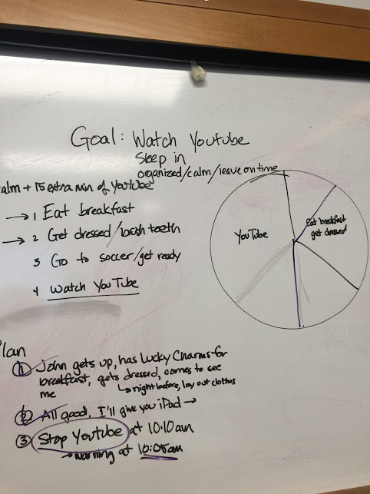
What are your children doing in their group?
Whole group greeting/introduction lesson
Game/interactive activity
Wrap up/Review
Cash in
© Unstuck Authors

Slide 9
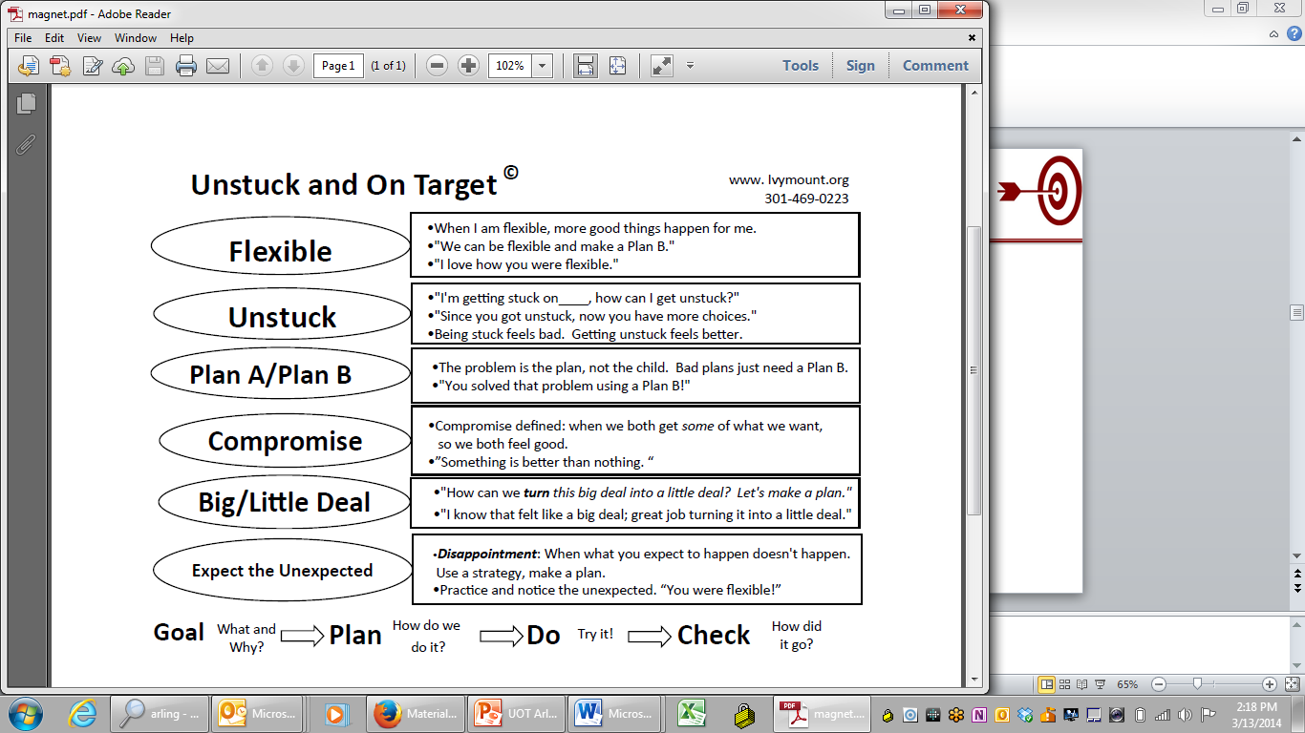

Slide 10
Relationship between Parent Group and Child Group
Children
Learning how to flexibly problem solve
Learning language/scripts
Learning managing themselves in a group
Learning how flexibility relates to friendship
Thinking in advance to make a plan
Parent
Learning how to flexibly problem solve
Learning language/scripts
Learning managing themselves in a group
Learning how flexibility relates to friendship
Thinking in advance to make a plan
Learning how to Live out Loud
© Unstuck Authors

Slide 11
Not What I Expected by Rita Eichenstein
Hopes, expectations, dreams
Feelings of anger, disappointment, sadness, guilt
Feelings leak out in parent bx
Child internalizes parent feelings as criticism
© Unstuck Authors

Slide 12
Parent Job: Live Your Life Out Loud
Model for your child that you too are learning how to be flexible and solve problems together by making a plan b
  You’re BOTH in class
  Get out of jail free card
Narrate your struggle with flexibility and problem solving
  You get stuck too
  You may do something the “old way”
    Stop and say “I got stuck in the old way. I need to think about a plan b. Give me a minute.”
Make being a flexible problem solvers a family value
© Unstuck Authors

Slide 13
List three things you do at least five times a week with your child:
I was flexible by/when I: _____________________________________
What can you say when you catch your child being flexible?
© Unstuck Authors

Slide 14
Goal: Get Organized and Oriented
Why? Because we all feel better when we know the plan!
Plan:
Introduction to Unstuck
Prize certificates
Ef Scales
Do:
Check:
© Unstuck Authors

Slide 15
Homework
Prize Certificates
EF Scales
Catch your child being flexible
© Unstuck Authors

